Slide 1
CS 547
Week 2 Day 2
PHP : Forms
MySQL

Slide 2
Agenda
Web Forms
MySQL

Slide 3
Announcements

Slide 4
Review
From previous lecture
Arrays
Indexed
Associative
Multidimensional
Bootstrap

Slide 5
PHP Language
Today:
Web Forms
MySQL

Slide 6
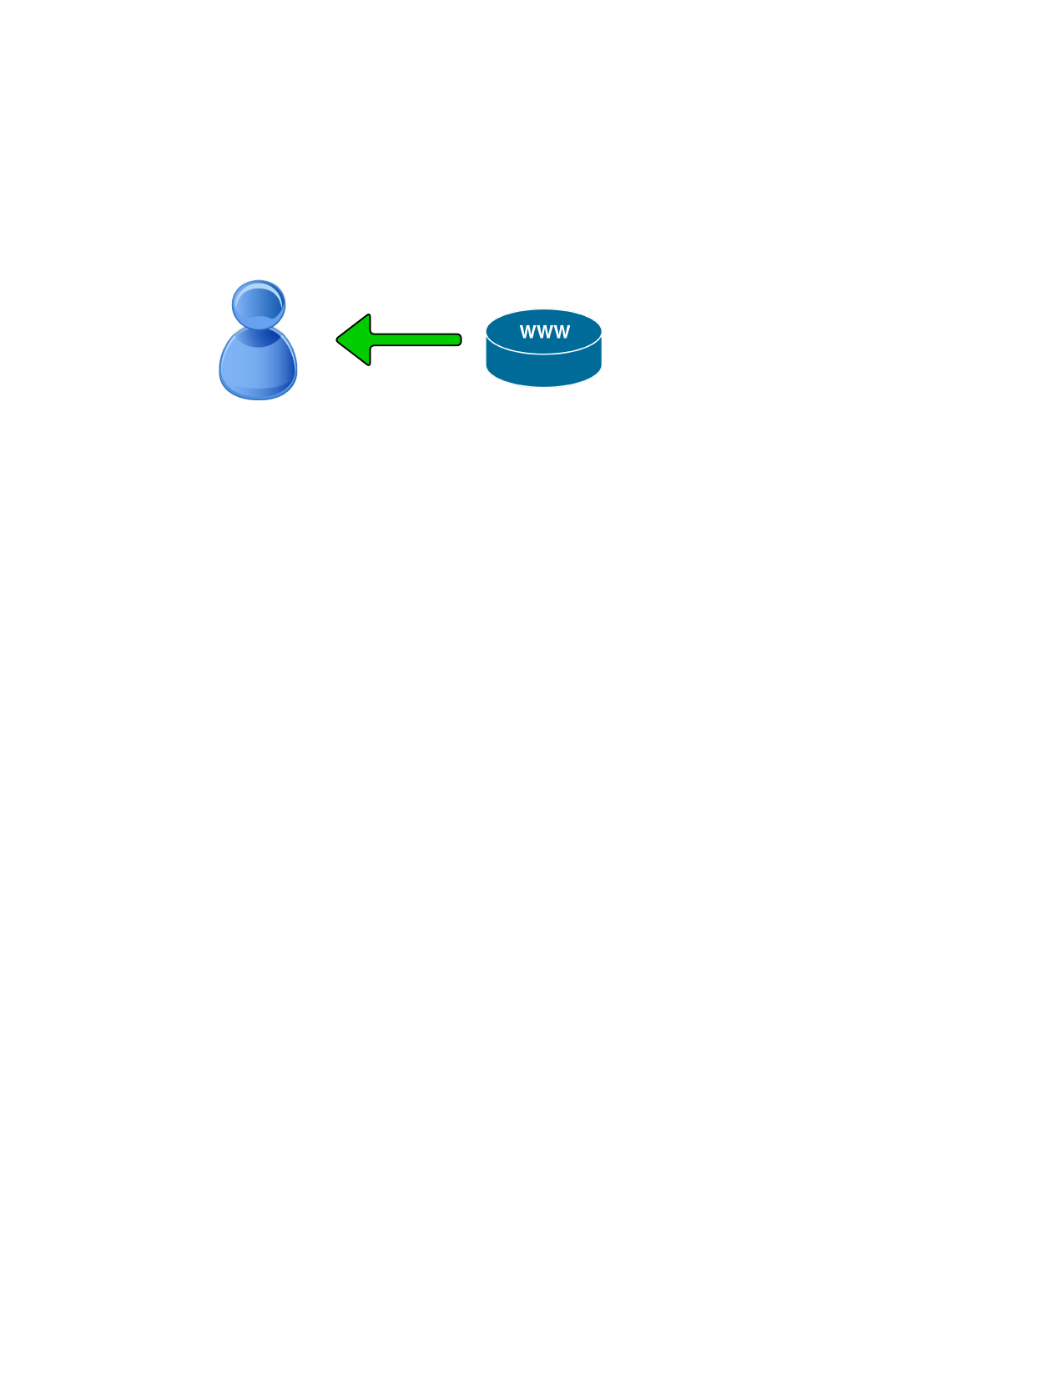
PHP Web Forms
PHP can be used to display information from the server to the user.
Notes:
Recall from last lecture….

Slide 7
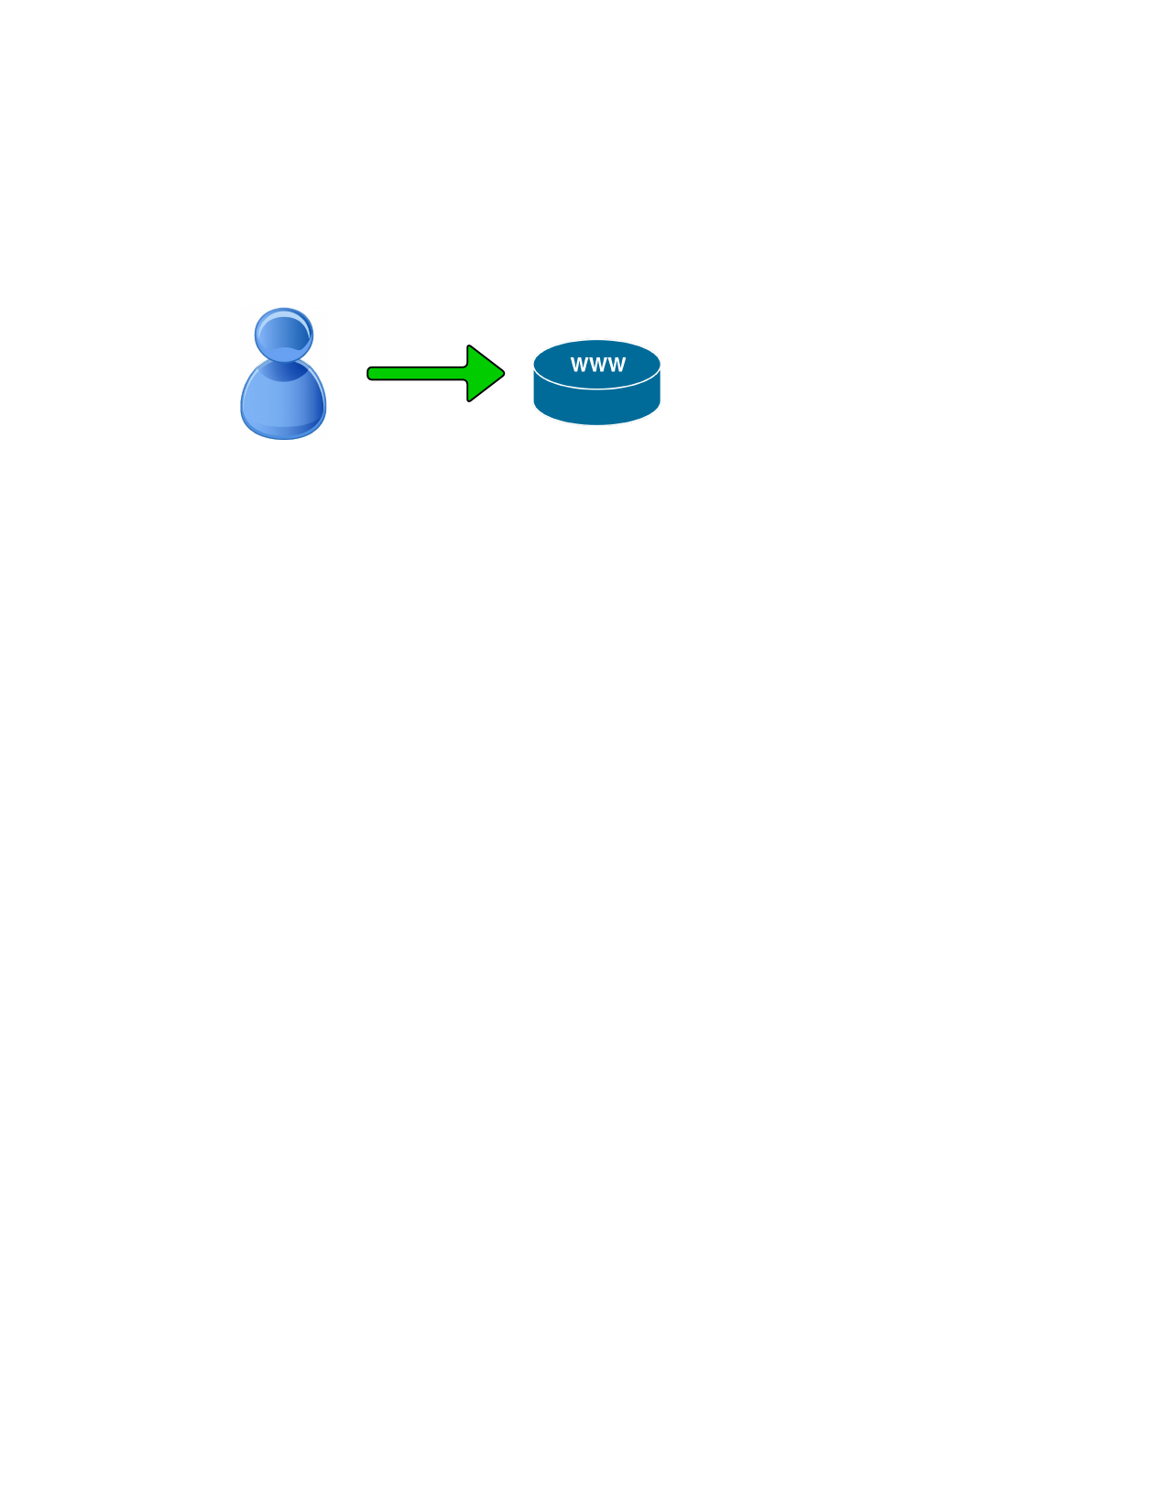
PHP Web Forms
But what if we wanted to get information from the user back to the server?
Notes:
Recall from last lecture….

Slide 8
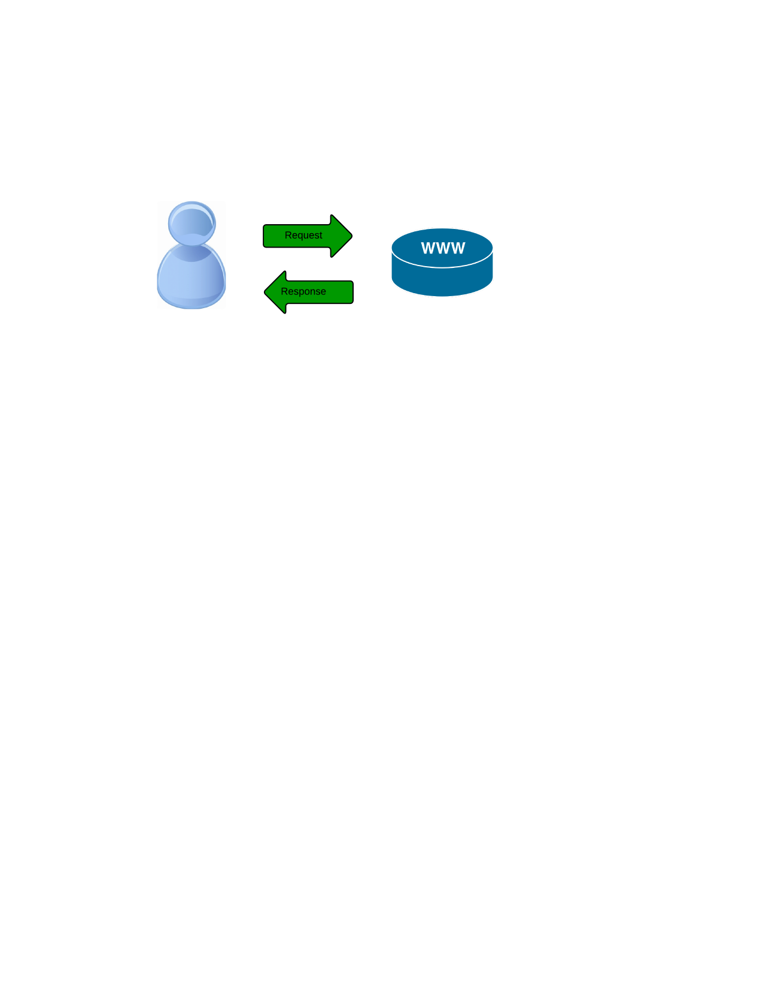
HTTP Request Review
The HTTP (Hyper Text Transfer Protocol) is used to exchange information. Recall that
Stateless protocol
Request and Response
URL (Uniform Resource Locator)

Slide 9
HTTP Verbs
GET fetch an existing resource. The URL contains all the necessary information the server needs to locate and return the resource.
POST create a new resource. POST requests usually carry a payload that specifies the data for the new resource.
PUT update an existing resource. The payload may contain the updated data for the resource
DELETE delete an existing resource.
Notes:
These are the most popular verbs, but there are a few more.

Slide 10
HTTP Verbs Less Popular
HEAD: this is similar to GET, but without the message body. It's used to retrieve the server headers for a particular resource, generally to check if the resource has changed, via timestamps.
TRACE: used to retrieve the hops that a request takes to round trip from the server. Each intermediate proxy or gateway would inject its IP or DNS name into the Via header field. This can be used for diagnostic purposes.
OPTIONS: used to retrieve the server capabilities. On the client-side, it can be used to modify the request based on what the server can support.
Notes:
These are the most popular verbs, but there are a few more.

Slide 11
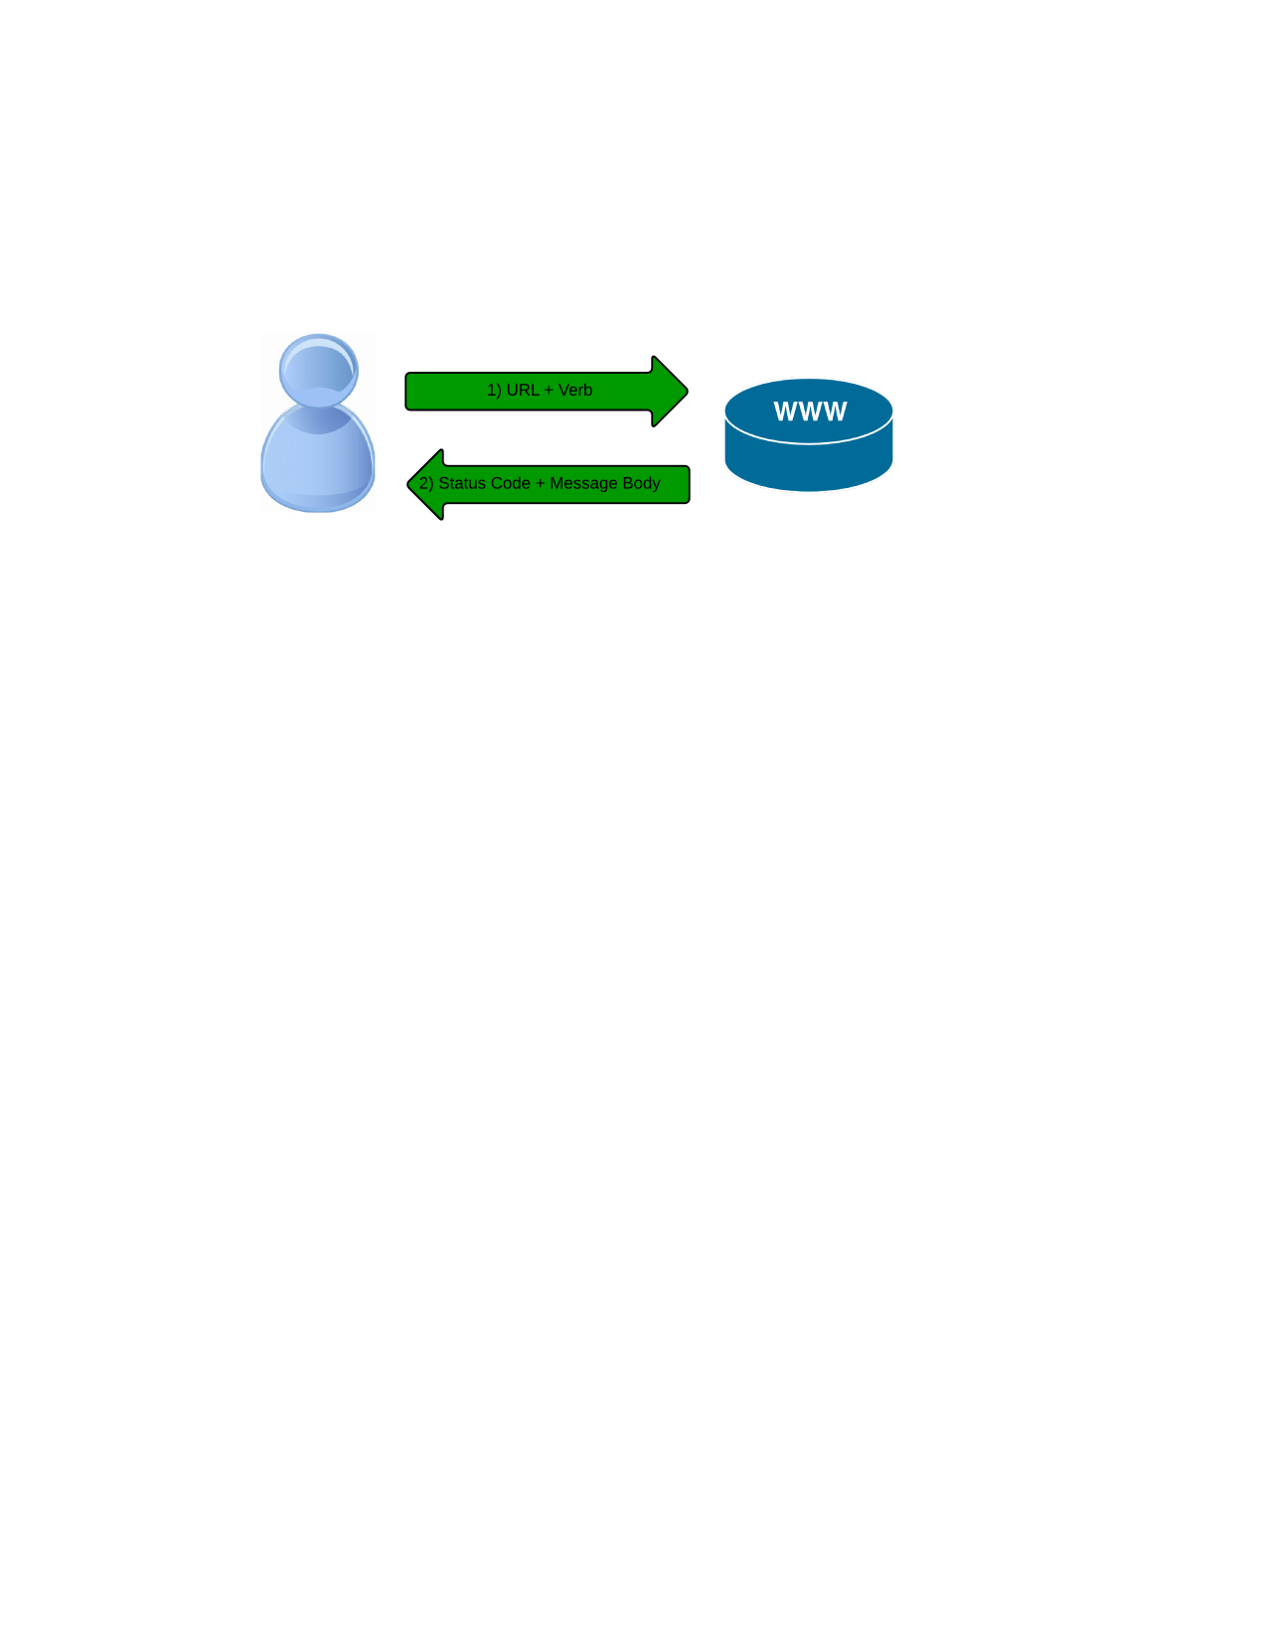
Response Status Codes
With URLs and verbs, the client can initiate requests to the server. In return, the server responds with status codes and message payloads. The status code is important and tells the client how to interpret the server response.

Slide 12
HTTP Status Codes
There are lots of status codes. The codes are Numeric and defined in the
protocol definition.
Notes:
See the rfc at http://www.w3.org/Protocols/rfc2616/rfc2616.html for further details

Slide 13
HTTP Common Status Codes
2xx: Successful.
200 – OK
202 – Accepted: the request was accepted
204 – No Content: there is no message body
Notes:
200 – OK
202 – Accepted: the request was accepted but may not include the resource in the response. This is useful for async processing on the server side. The server may choose to send information for monitoring
204 No Content: there is no message body in the response

Slide 14
HTTP Common Status Codes
3xx: Redirection.
301 – Moved Permanently
303 – See other Response contains temp url
304 – Not modified - cache
Notes:
301 Moved Permanently: the resource is now located at a new URL.
303 See Other: the resource is temporarily located at a new URL. TheLocation response header contains the temporary URL.
304 Not Modified: the server has determined that the resource has not changed and the client should use its cached copy. This relies on the fact that the client is sending ETag (Enttity Tag) information that is a hash of the content. The server compares this with its own computed ETag to check for modifications.

Slide 15
HTTP Common Status Codes
4xx: Client Error.
400 – Bad Request: the request was malformed
401 – Unauthorized: request requires authentication
403 – Forbidden
404 – Not found.
Notes:
These codes are used when the server thinks that the client is at fault, either by requesting an invalid resource or making a bad request. The most popular code in this class is 404 Not Found, which I think everyone will identify with. 404 indicates that the resource is invalid and does not exist on the server. The other codes in this class include:
400 Bad Request: the request was malformed.
401 Unauthorized: request requires authentication. The client can repeat the request with the Authorization header. If the client already included theAuthorization header, then the credentials were wrong.
403 Forbidden: server has denied access to the resource.
405 Method Not Allowed: invalid HTTP verb used in the request line, or the server does not support that verb.
409 Conflict: the server could not complete the request because the client is trying to modify a resource that is newer than the client's timestamp. Conflicts arise mostly for PUT requests during collaborative edits on a resource.

Slide 16

HTTP Common Status Codes
404: From GitHub.
Notes:
One of my favorite error pages. Note the Z depth on the actual page as you scroll your mouse around.

Slide 17
HTTP Common Status Codes
5xx: Server Error.
500 – Internal Server Erros. Something is wrong
501 – Not Implemented
503 – Service Unavailable
Notes:
This class of codes are used to indicate a server failure while processing the request. The most commonly used error code is 500 Internal Server Error. The others in this class are:
501 Not Implemented: the server does not yet support the requested functionality.
503 Service Unavailable: this could happen if an internal system on the server has failed or the server is overloaded. Typically, the server won't even respond and the request will timeout.

Slide 18
HTTP Message Body
The HTTP specification states that a request or response message has the following generic structure:
message = <start-line>
*(<message-header>)
CRLF
[<message-body>]
<start-line> = Request-Line | Status-Line
<message-header> = Field-Name ':' Field-Value
Notes:
It's mandatory to place a new line between the message headers and body. The message can contain one or more headers, of which are broadly classified into:
general headers: that are applicable for both request and response messages.
request specific headers.
response specific headers.
entity headers.
The message body may contain the complete entity data, or it may be piecemeal if the chunked encoding (Transfer-Encoding: chunked) is used. All HTTP/1.1 clients are required to accept the Transfer-Encoding header.

Slide 19
Tools for viewing HTTP Traffic
Popular tools
Chrome DevTools built into the browser
Firefox Developer Tools
Notes:
Homework- spend about an hour working with one of the first two tools

Slide 20
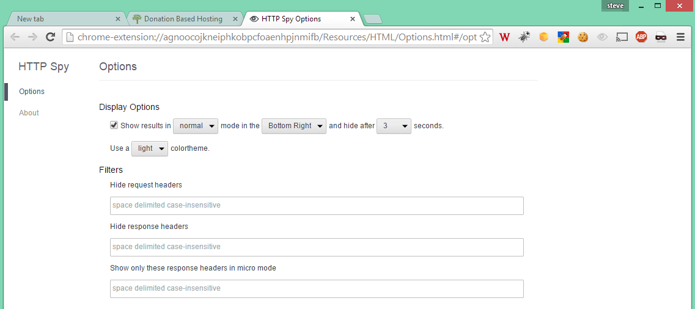
Tools: Also usefull – Http Spy Addon
Notes:
HomeWork- Download and install

Slide 21
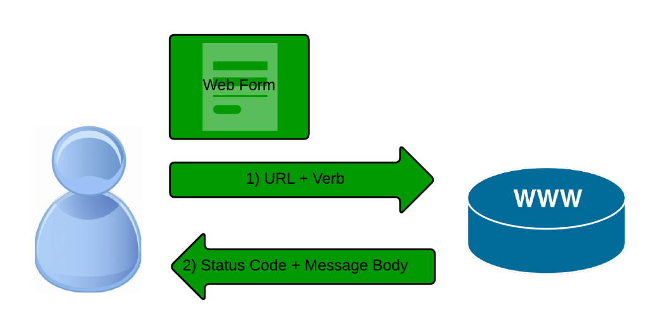
Web Forms
Now we can start talking about Web Forms.
Notes:
Finally! With the past 17 slides as background we can talk about a web form.

Slide 22
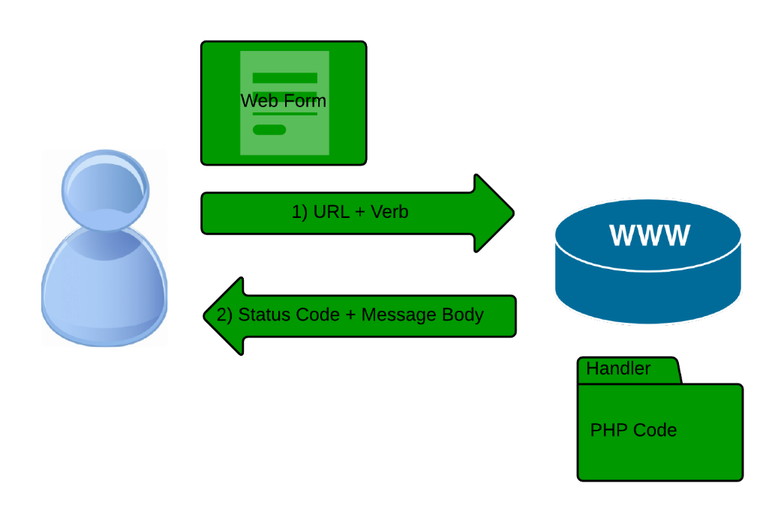
Web Forms
There are two parts to the conversation.
HTML Form
Form Handler
Notes:
Two parts must be coordinated.

Slide 23

HTML Forms
Coded in HTML as:
<form action=“hello.php" method="post">
<input type="submit"> </form>
Notes:
Two parts must be coordinated.

Slide 24
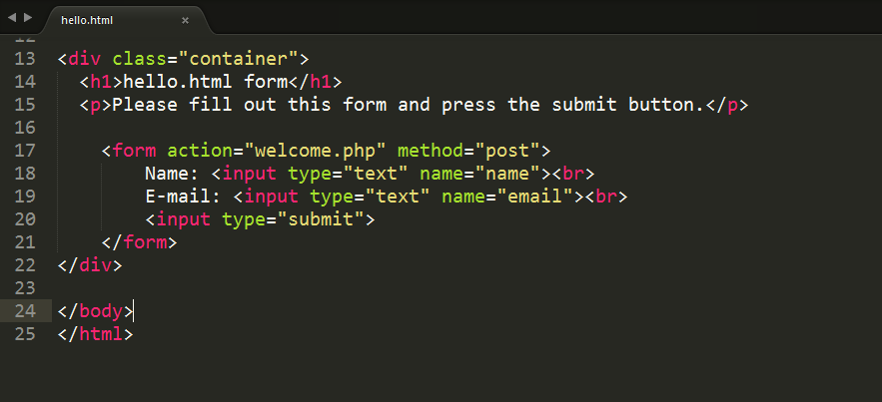
HTML Forms
Notes:
Code Example

Slide 25
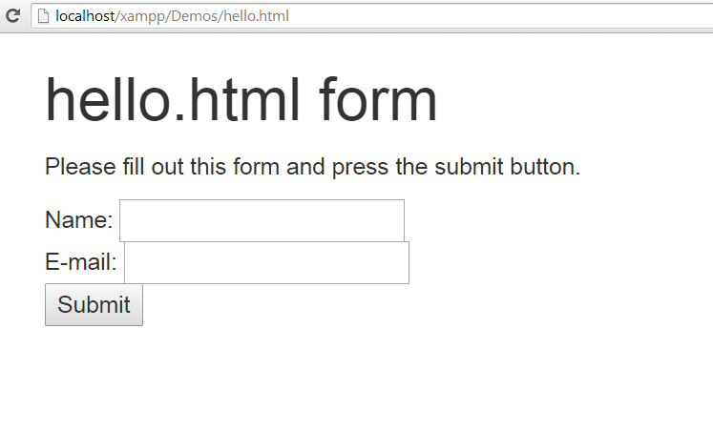
HTML Forms
Notes:
HTML in browser. What happens if we submit this form?

Slide 26
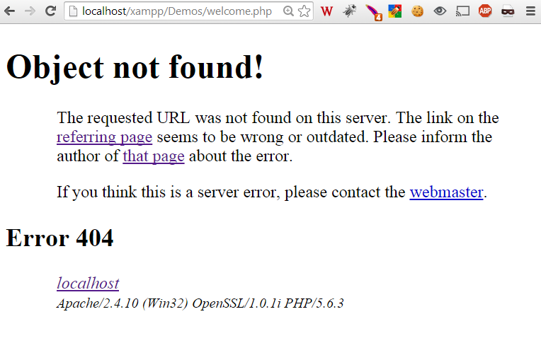
HTML Forms
This is not good.
How do we fix this?
Notes:
Whoops. How do we fix this?

Slide 27
Form Handler
Need a form handler to process the
form request no the server.
Welcome <?php echo $_POST["name"]; ?><br> Your email address is: <?php echo $_POST["email"]; ?>
Notes:
Two parts must be coordinated.

Slide 28
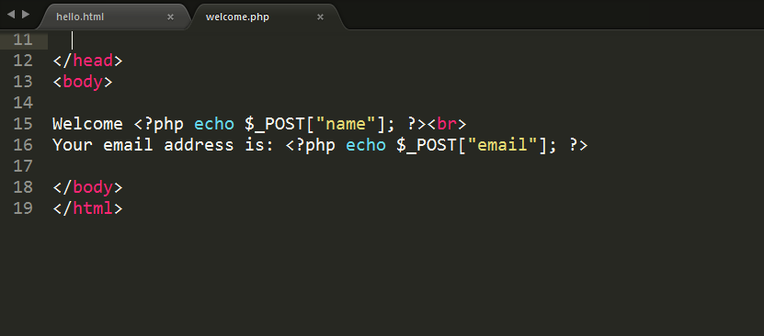
Form Handler
Notes:
Make sure the form is readable and executable by the web server process.

Slide 29
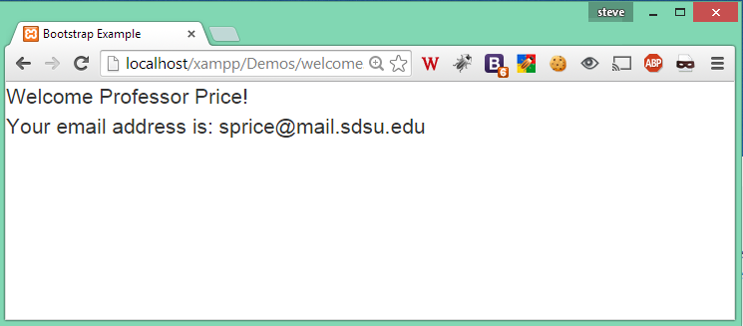
Form Handler output
Notes:
Success.
But how did we do that?

Slide 30
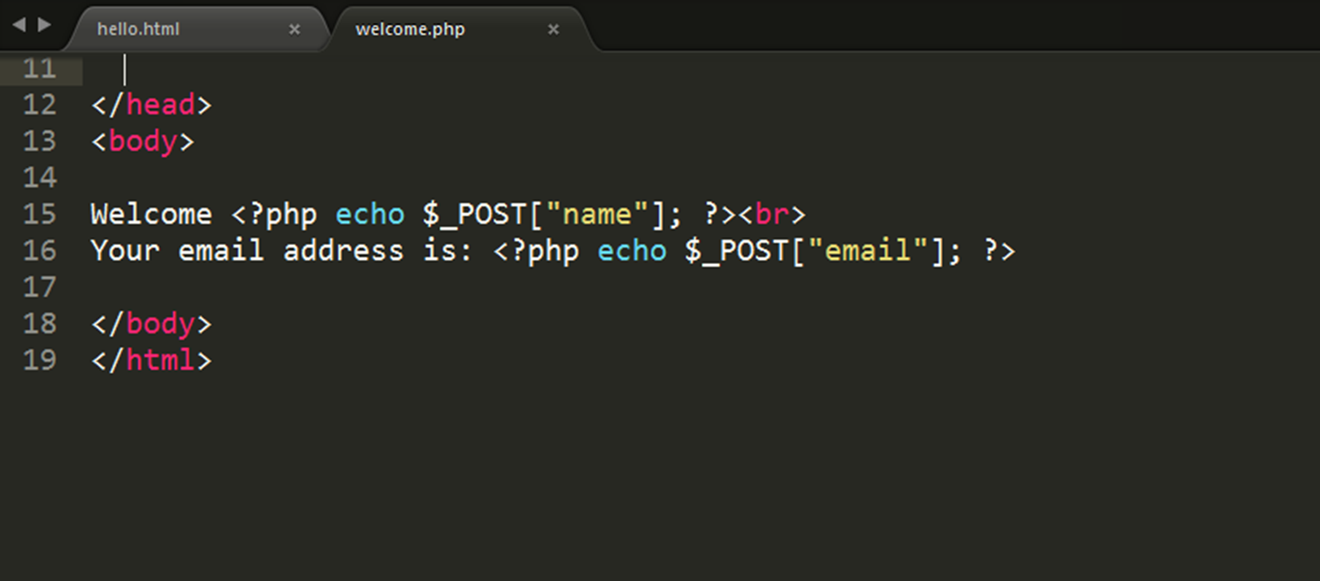
Form Handler output
Great! But how does it work?
Notes:
Success.
But how did we do that?

Slide 31
Notice…
the
$_POST["name"];
And
$_POST["email"];
These are special Superglobal variables built in to PHP.
Notes:
These are special PHP variables. There are a bunch of them

Slide 32
PHP SuperGlobal Variables
The PHP superglobal variables are:
$GLOBALS
$_SERVER
$_REQUEST
$_POST
$_GET
$_FILES
$_ENV
$_COOKIE
$_SESSION
Notes:
Several predefined variables in PHP are "superglobals“.
These are always accessible, regardless of scope –
can access them from any function,
class or file without having to do anything special.
There are a bunch of them

Slide 33
PHP $GLOBALS
PHP stores all global variables in an array called $GLOBALS[index]. The index holds the name of the variable.
<?php $x = 75; $y = 25; function addition() { $GLOBALS['z'] = $GLOBALS['x'] + $GLOBALS['y']; } addition(); echo $z; ?>
Notes:
Always there regardless of scope.

Slide 34
PHP $_SERVER
Holds information about headers, paths, and script locations.
There are 24 elements defined.
Notes:
Very important! On the exam.
holds information about headers, paths, and script locations

Slide 35
PHP $_SERVER
Element/Code | Description
$_SERVER['PHP_SELF'] | Returns the filename of the currently executing script
$_SERVER['GATEWAY_INTERFACE'] | Returns the version of the Common Gateway Interface (CGI) the server is using
$_SERVER['SERVER_ADDR'] | Returns the IP address of the host server
$_SERVER['SERVER_NAME'] | Returns the name of the host server (such as www.w3schools.com)
$_SERVER['SERVER_SOFTWARE'] | Returns the server identification string (such as Apache/2.2.24)
$_SERVER['SERVER_PROTOCOL'] | Returns the name and revision of the information protocol (such as HTTP/1.1)
$_SERVER['REQUEST_METHOD'] | Returns the request method used to access the page (such as POST)
Notes:
Very important! On the exam.
holds information about headers, paths, and script locations

Slide 36
PHP $_SERVER
Element/Code | Description
$_SERVER['REQUEST_TIME'] | Returns the timestamp of the start of the request (such as 1377687496)
$_SERVER['QUERY_STRING'] | Returns the query string if the page is accessed via a query string
$_SERVER['HTTP_ACCEPT'] | Returns the Accept header from the current request
$_SERVER['HTTP_ACCEPT_CHARSET'] | Returns the Accept_Charset header from the current request (such as utf-8,ISO-8859-1)
$_SERVER['HTTP_HOST'] | Returns the Host header from the current request
$_SERVER['HTTP_REFERER'] | Returns the complete URL of the current page (not reliable because not all user-agents support it)
$_SERVER['HTTPS'] | Is the script queried through a secure HTTP protocol
$_SERVER['REMOTE_ADDR'] | Returns the IP address from where the user is viewing the current page
Notes:
Very important! On the exam.
holds information about headers, paths, and script locations

Slide 37
PHP $_SERVER
Element/Code | Description
$_SERVER['REMOTE_HOST'] | Returns the Host name from where the user is viewing the current page
$_SERVER['REMOTE_PORT'] | Returns the port being used on the user's machine to communicate with the web server
$_SERVER['SCRIPT_FILENAME'] | Returns the absolute pathname of the currently executing script
$_SERVER['SERVER_ADMIN'] | Returns the value given to the SERVER_ADMIN directive in the web server configuration file (if your script runs on a virtual host, it will be the value defined for that virtual host) (such as someone@w3schools.com)
$_SERVER['SERVER_PORT'] | Returns the port on the server machine being used by the web server for communication (such as 80)
Notes:
Very important! On the exam.
holds information about headers, paths, and script locations

Slide 38
PHP $_SERVER
Element/Code | Description
$_SERVER['SERVER_SIGNATURE'] | Returns the server version and virtual host name which are added to server-generated pages
$_SERVER['PATH_TRANSLATED'] | Returns the file system based path to the current script
$_SERVER['SCRIPT_NAME'] | Returns the path of the current script
$_SERVER['SCRIPT_URI'] | Returns the URI of the current page
Notes:
Very important! On the exam.
holds information about headers, paths, and script locations

Slide 39
PHP $_REQUEST
$_REQUEST is used to collect data after submitting an HTML form.

Slide 40
PHP $_POST
$_POST is widely used to collect form data after submitting an HTML form with method="post". $_POST is also widely used to pass variables.
The values in your PHP Handler must match the values in your HTML Form.

Slide 41
PHP $_POST
Notes:
It is very important that the values in your PHP Handler must match the values in your HTML Form.

Slide 42
PHP $_GET
$_GET can also be used to collect form data after submitting an HTML form with method="get".

Slide 43
Note about POST and GET
The GET and POST verbs are often used in a similar fashion, but they have greatly different behaviours.
GET – passes variables on the URL
POST – passes variables in a new connection.
Notes:
Important to know. We will revisit this soon.

Slide 44
PHP $_FILES
Used to upload files.

Slide 45
PHP $_ENV
Used to return the environment variables form the web server.

Slide 46
PHP $_COOKIE
Cookies are small text files loaded from a server to a client computer storing some information regarding the client computer, so that when the same page from the server is visited by the user, necessary informations can be collected from the cookie itself, decreasing the latency to open the page.
Notes:
Cookie are not good or bad, it depends on how you use them

Slide 47
PHP $_SESSION
Sessions are a way to store state information on the server.
To start a session call the function
session_start();
In your handler. Then you can add useful information to the $_SESSION array.
Notes:
This is a very powerfull tool in web application programming. We will revisit this again.

Slide 48
Next Topic
Setting up MySQL in your development environment.

Slide 49
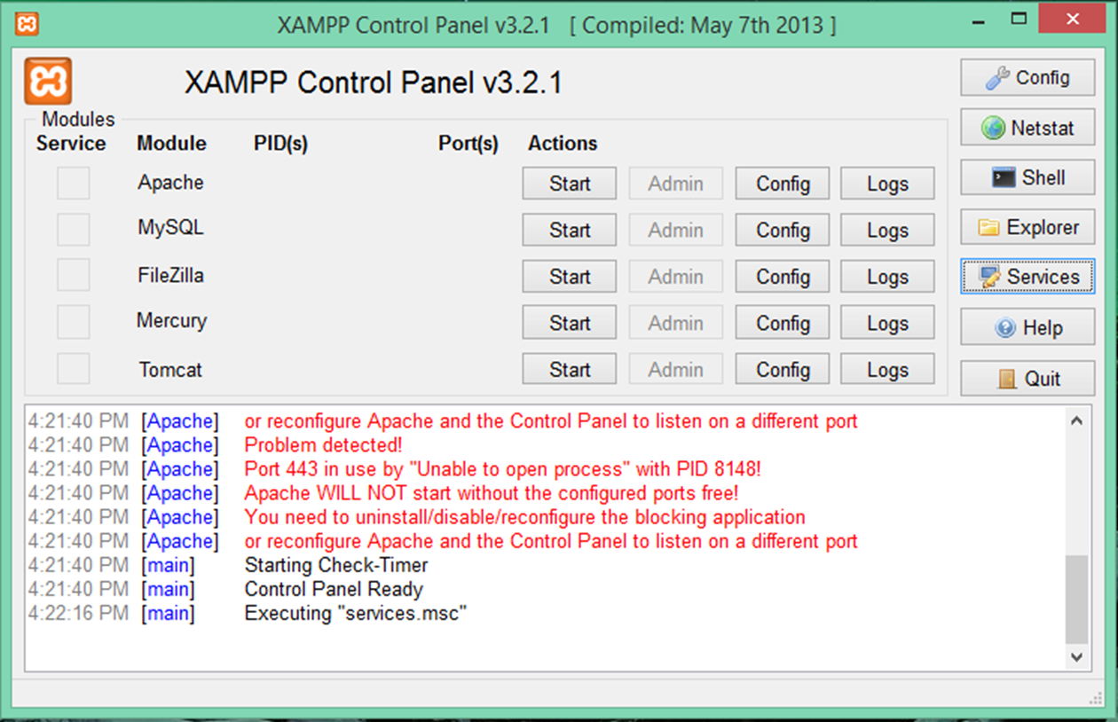
XAMPP
Open the XAMPP Control Panel
Notes:
I would like to encourage everyone to open up and start the XAMP control panel.

Slide 50
Start using the tools
Start the xamp control panel
Start the apache web service
Notes:
The best way to learn is by doing.

Slide 51
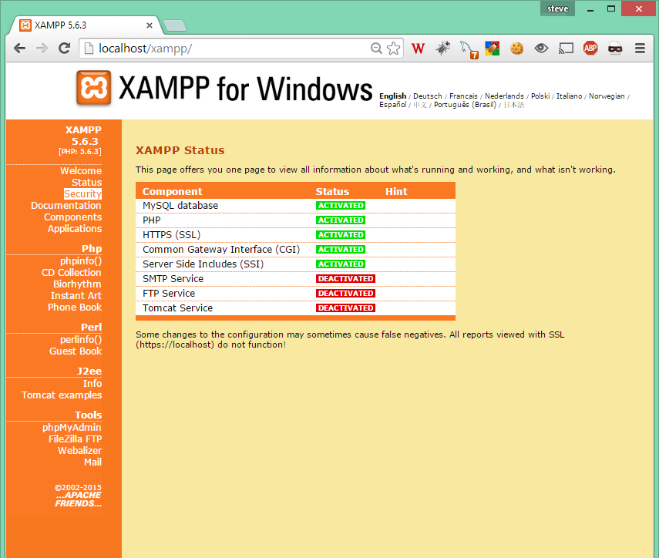
XAMPP
Navigate to the main page
Click the Security link
Notes:
The best way to learn is by doing.

Slide 52
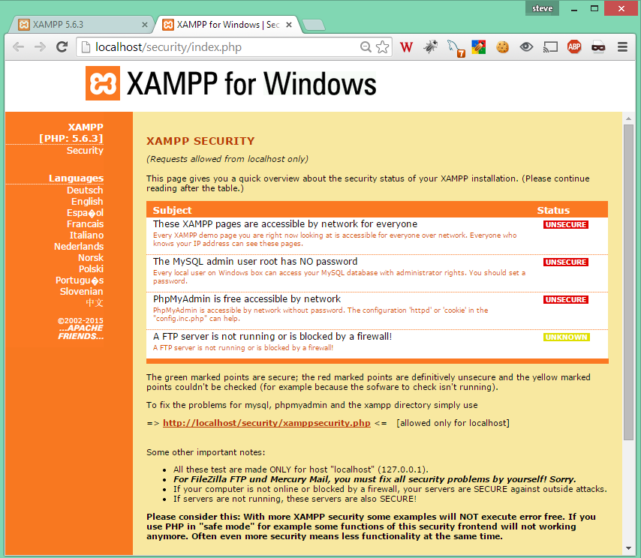
XAMPP
This will open a new tab
Click the xamppsecurity.php link to secure your system
Notes:
The best way to learn is by doing.

